Slide 1

MEGA INSIGHT
Service provider of Smart Manufacturing Solutions
Mega Insight Smart Manufacturing (Suzhou) Corp., Ltd.
Mega Insight Smart Manufacturing（Suzhou）Corp.,Ltd.

Slide 2
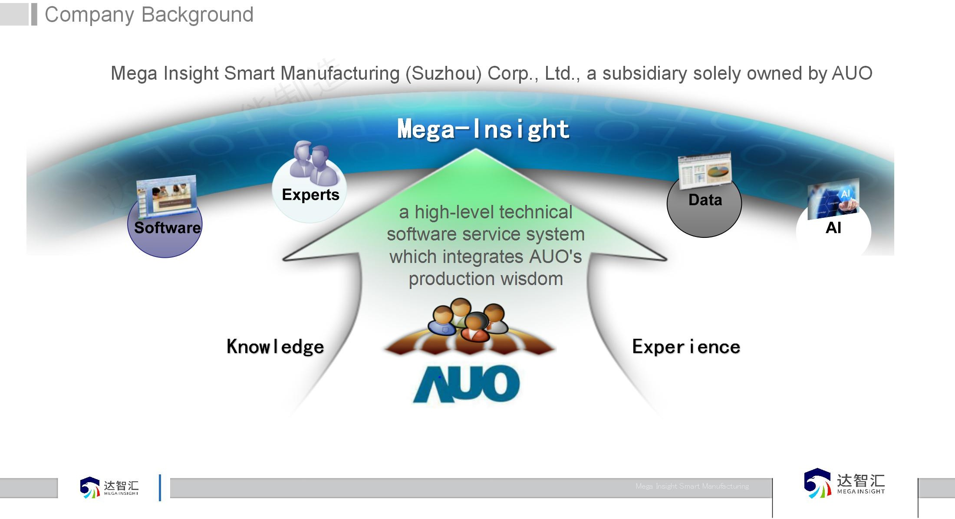




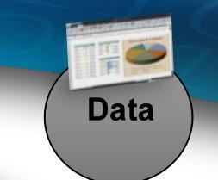















Company Background
Mega Insight Smart Manufacturing (Suzhou) Corp., Ltd., a subsidiary solely owned by AUO
汇智能制造
INSIGHT
智
达
MEGA
a high-level technical software service system which integrates AUO's production wisdom
MEGA INSIGHT

Slide 3
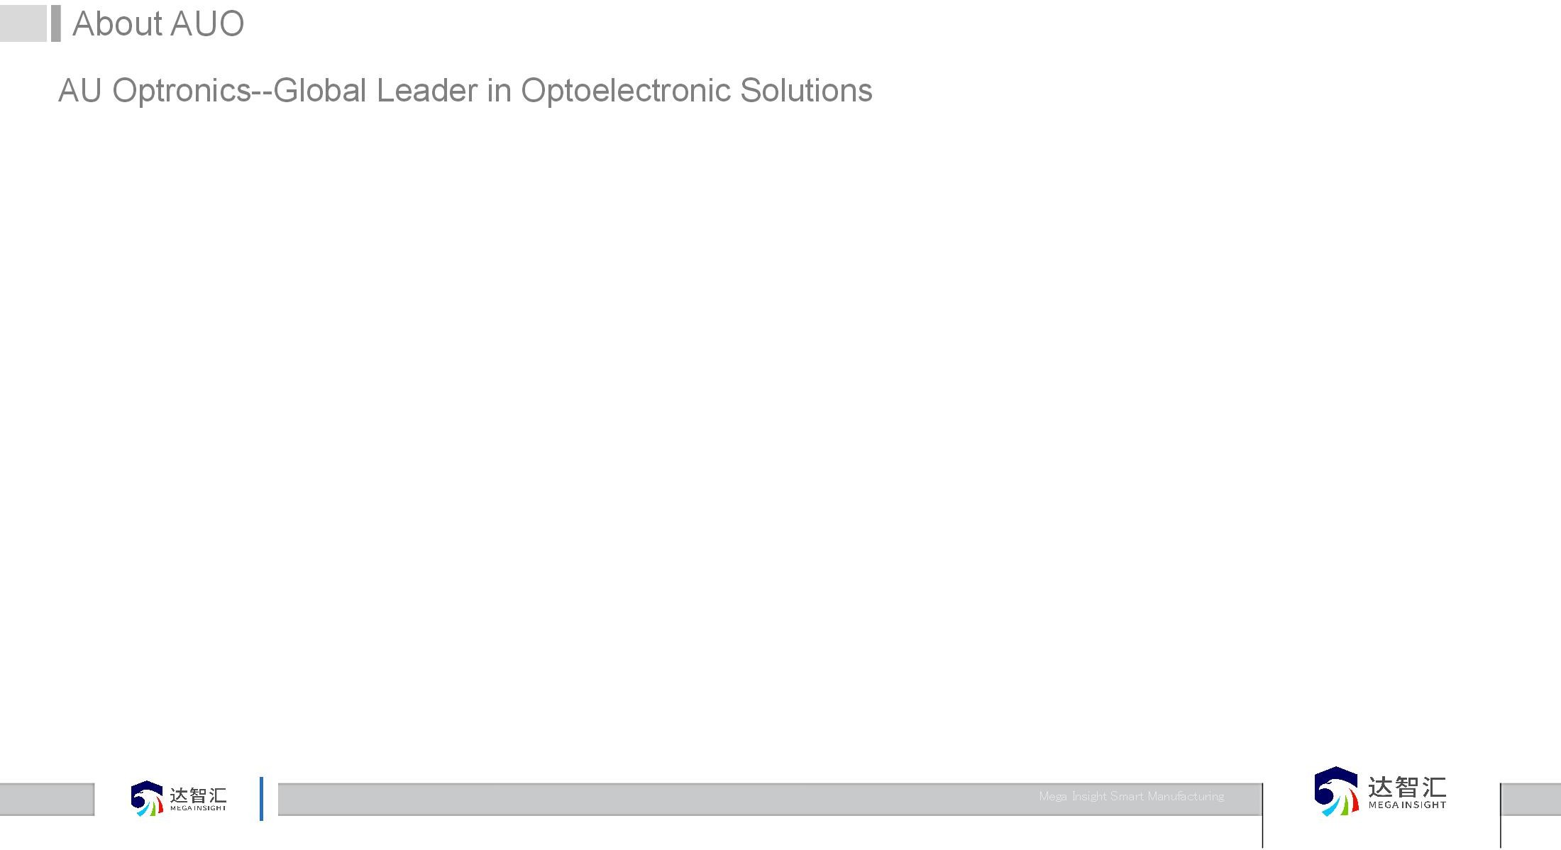


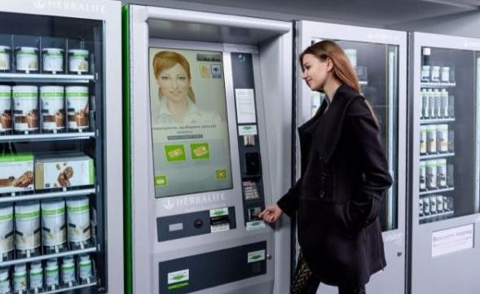

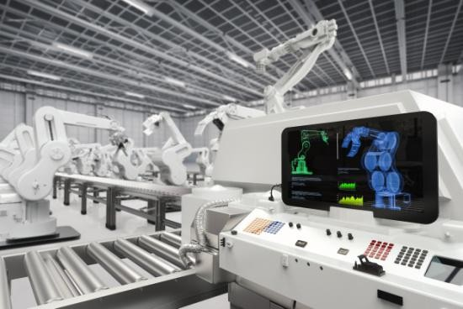
About AUO
INSIGHT
MEGA
Home
Personal Wear
Vehicle
Medical
Commercial
Retail
Meeting
Industrial
Founded in 1996 au optronics
Taiwan stock market listing in 2000
In 2002, the U.S. stock market listing
More than 40,000 employees worldwide
Over 70 Billion yuan Revenue Annually
More than 90% proportion System by independent research and development
More than 500 IT staffs’ support
More than 20 years of factory operation experiences
MEGA INSIGHT

Slide 4
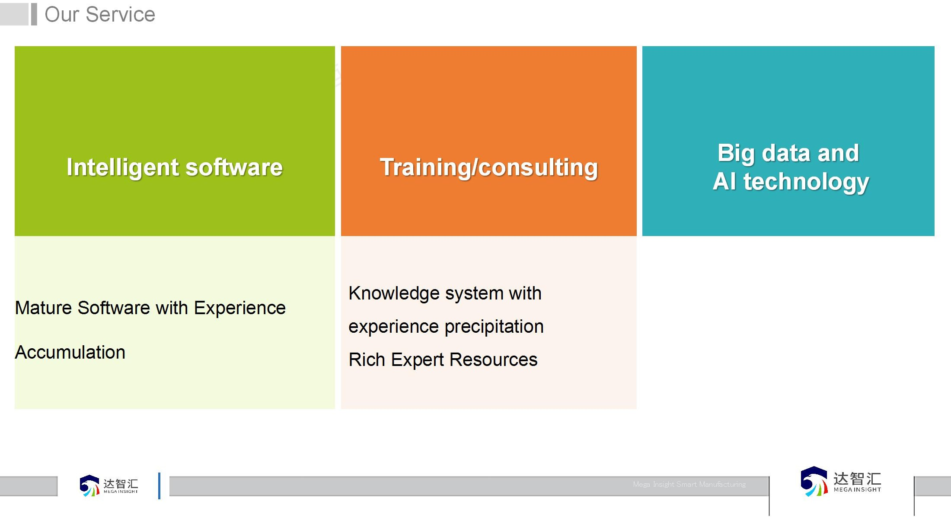
























Our Service
造 _{智能}制
_{达智}汇
1
2
3
INSIGHT
MEGA INSIGHT
MEGA
Knowledge system with experience precipitation Rich Expert Resources
A large number of AI new application scenarios
our practice of mature solution
Mature Software with Experience
Accumulation

Slide 5
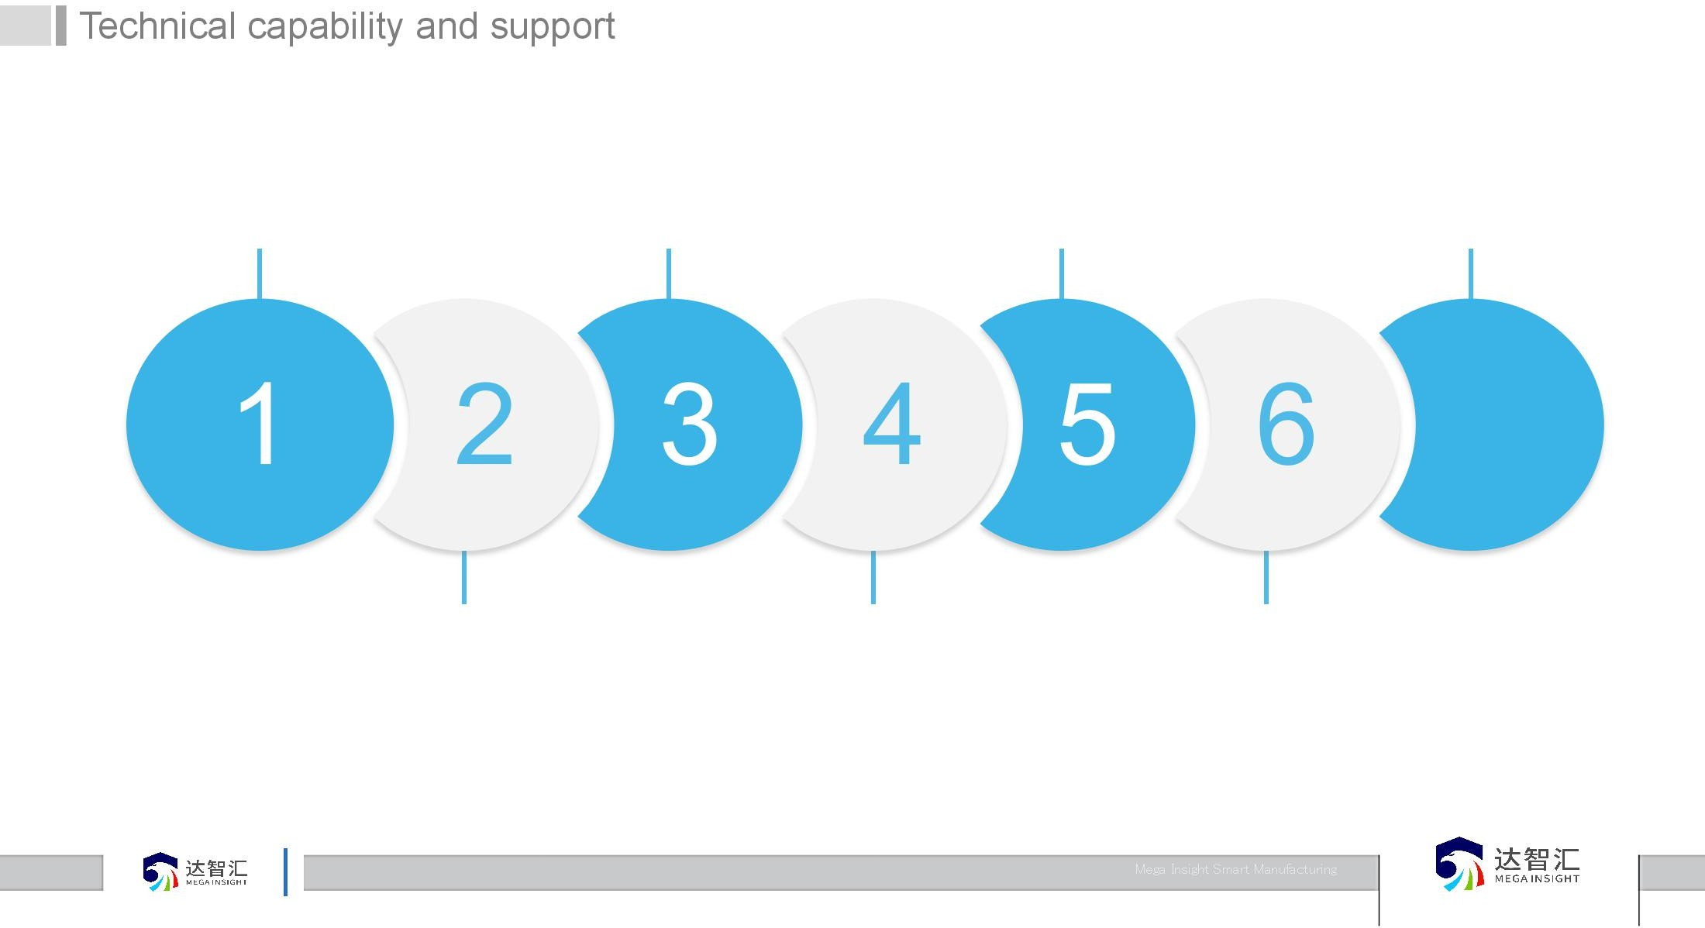







Technical capability and support
More than 300 sets of intelligent equipment are independently developed
Consultant>600 More than 10 years senior
consultant>300
80 big data project staff
Smart manufacturing workshop
MEGA INSIGHT
1 2 3 4 5 6 7
MEGA INSIGHT
More than 300 sets of management softward
More than 30 IOT solutions
More than 10 AI workshop solution

Slide 6



















Full lifecycle service support
INSIGHT
MEGA
From single factory to group management
From single system to comprehensive system integration
From production to business collaboration mode
System upgrade and iteration in the future by AI+ Big data
MEGA INSIGHT

Slide 7
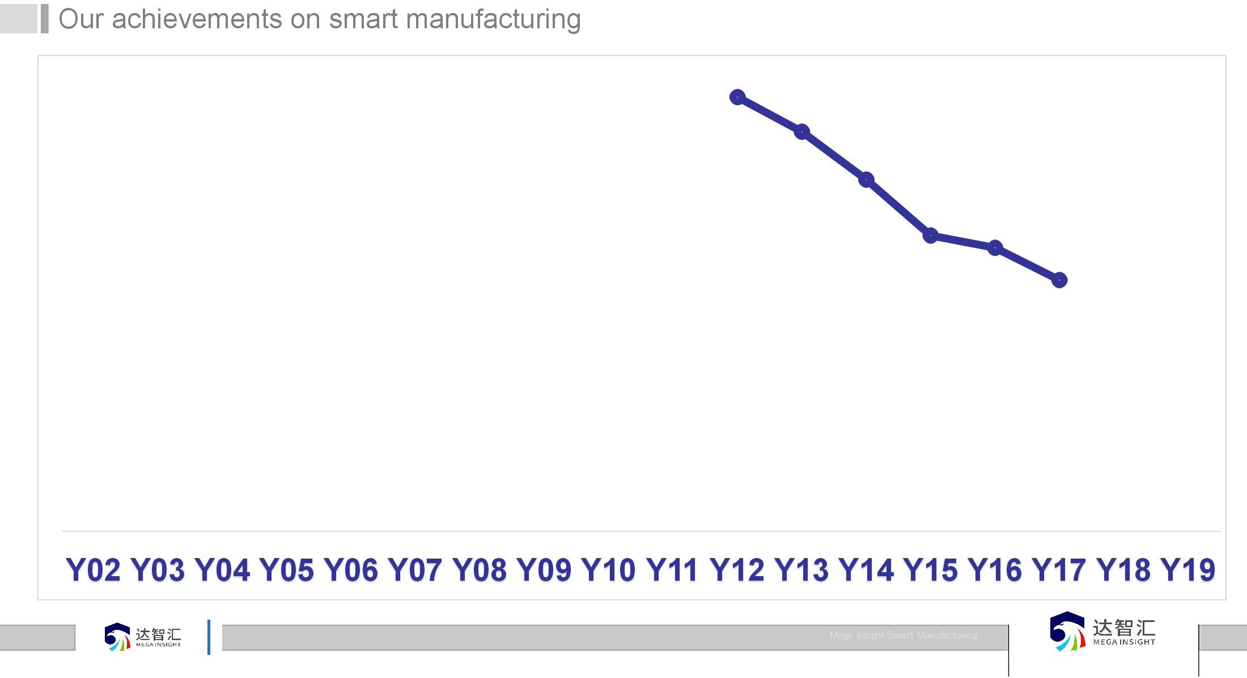
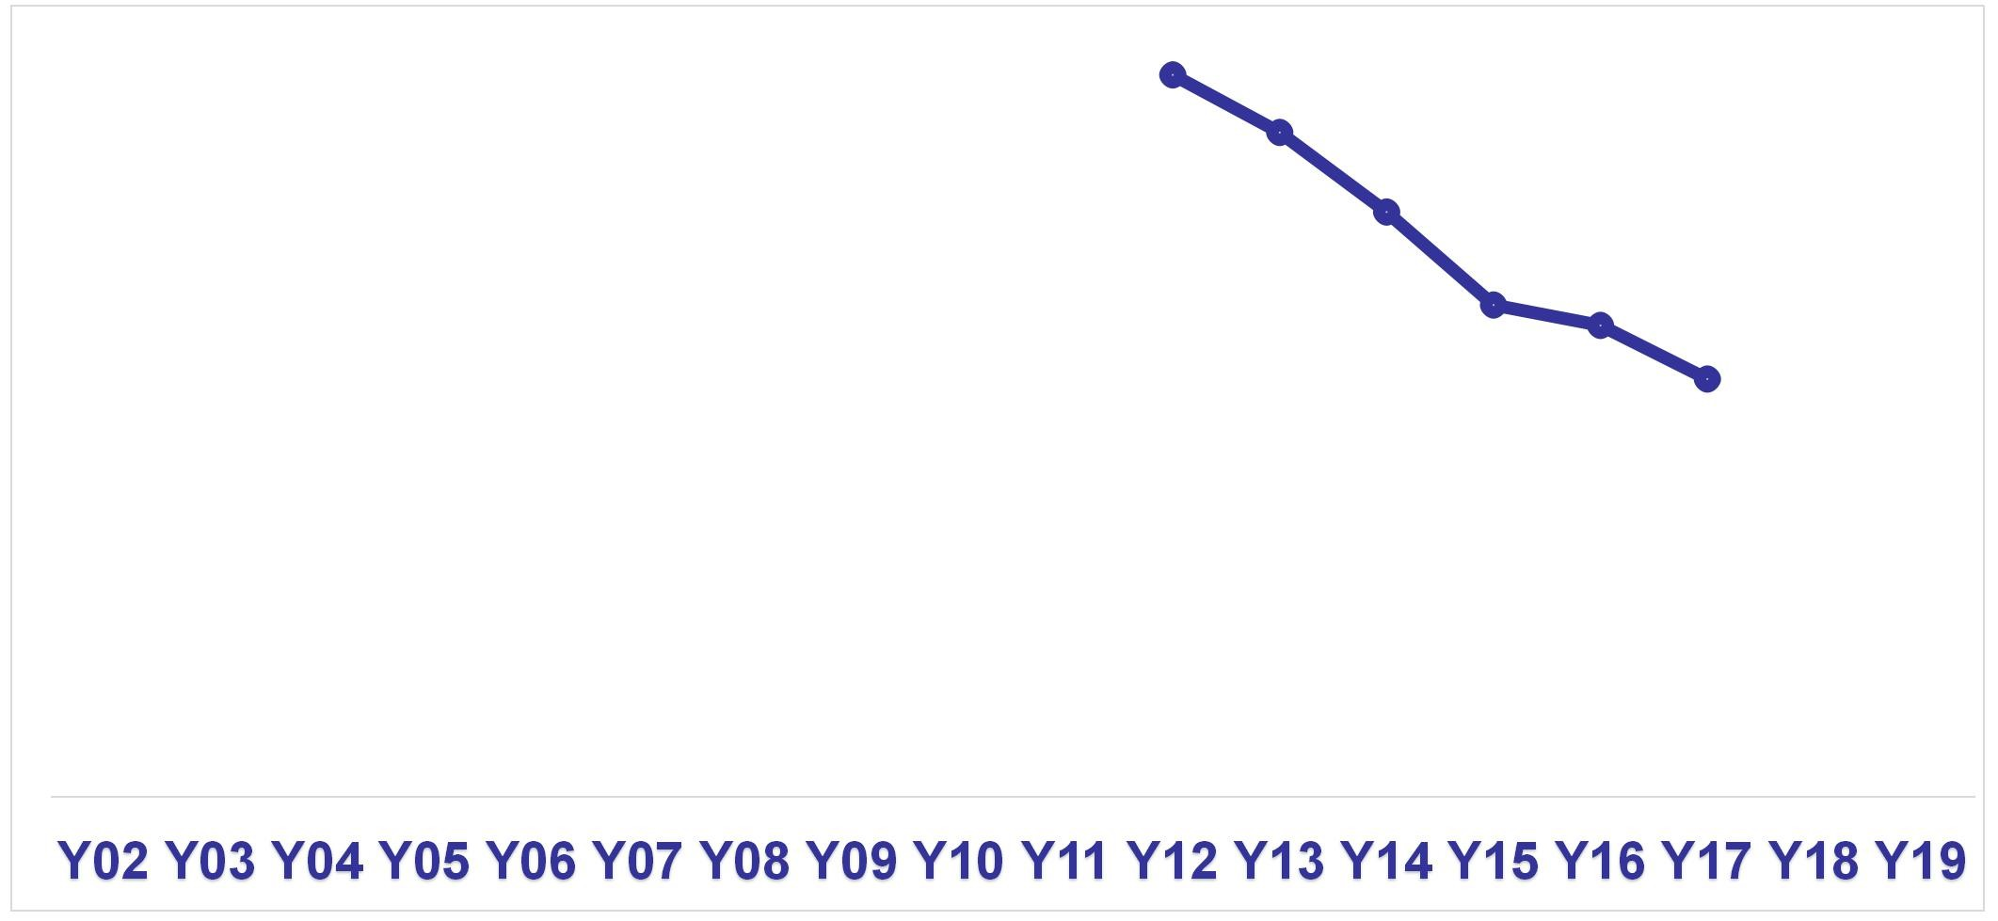

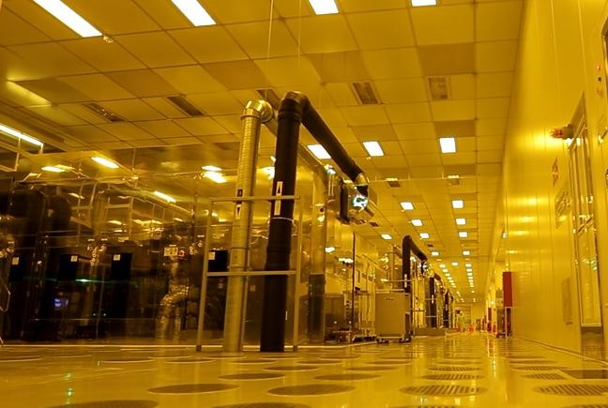
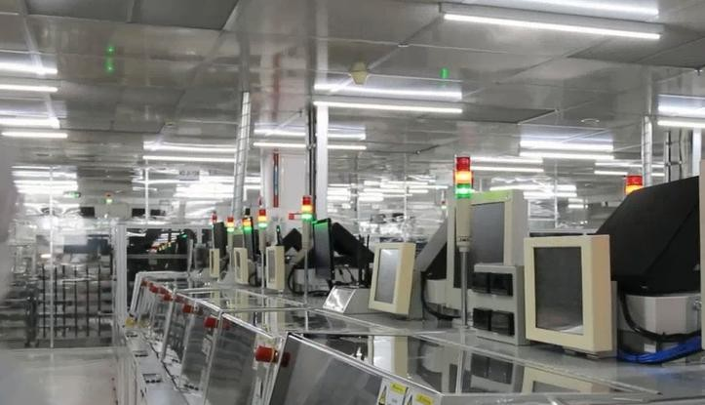
Our achievements on smart manufacturing
Management efficiency increases by 10%
Quality failure cost decreases by 15%
OEE increases by 10%
INSIGHT
MEGA
Smart manufacturing
Industry4.0
Automation
Lean Six Sigma
TPM
MEGA INSIGHT

Slide 8

System map (100% independent research and development)
INSIGHT
Value competition of self driving capability
制造
能
智
Architectural basic drive ability of the organization
Customer interaction
Supplier interaction
Equipment interaction
Design interaction
Logistics interaction
MEGA
_{达智}汇
Supply chain management
Plant safety management
Customer relationshop management
Shop Floor
Financial management
Human resource management
IT
management
Production management
Equipment management
Quality management
Warehouse management
Erengy management
Cost management
Intelligent scheduling
Kanban
Technical foundation of structure transformation ability
Big Data + AI
Process Data Equipment Data
Product Data
Environmental data
Industrial Ethernet RFID
Robot
AGV
AOI
PLC
Sensor
IPC
MEGA INSIGHT
The process foundation of structure transformation ability
Focus on the shop floor site - Lean + TPM

Slide 9
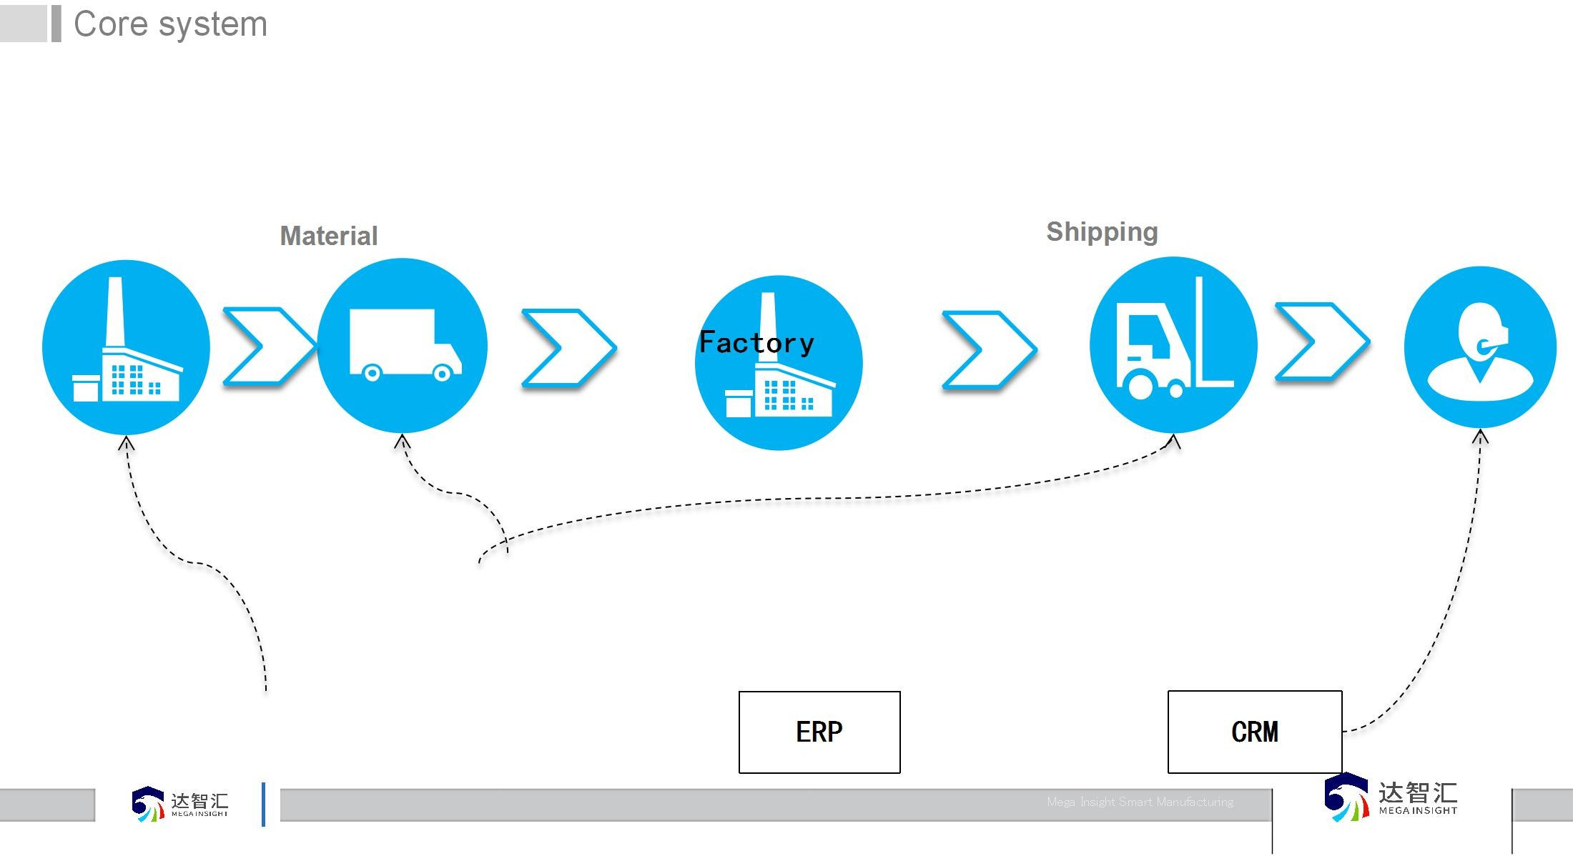







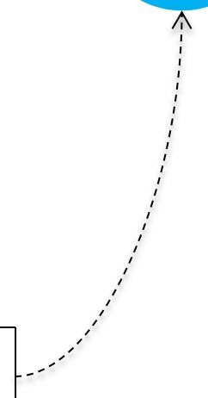
Core system
Equipment management system
Quality management system
INSIGHT
supplier
Material
Shipping
Customer
MEGA
Factory
MEGA INSIGHT
Warehouse management system
MES
Supplier relationship management
ERP
CRM

Slide 10





MES Standard function
Application
Group
Factory
Shop floor
PC
Mobile
Human
INSIGHT
Material Mgnt
Material Issue
Line Pool Return
Check Stock in
Label
Execution
Check In Split/Merge
Operation Packing Test Repair
Modeling
WO Plan
Role
Factory
Order
Plan
MEGA
User
Product
WO Create
Update
Authority
Operation
WO BOM
Close
Function
Quality
Equipment
Jig
Kanban
IQC
IPQC
Poka-yoke
SPC
Data Collect
OEE
Data collect
Monitor
Template
Setup
Material
Equipment
Work position
Management
OQC
Alarm
Call repair
Spare parts
Print
Basic data
History data
MEGA INSIGHT
System Interface
Support
product
Order
Authority
equipment
Material
Infrastructure
Data and Network
10

Slide 11
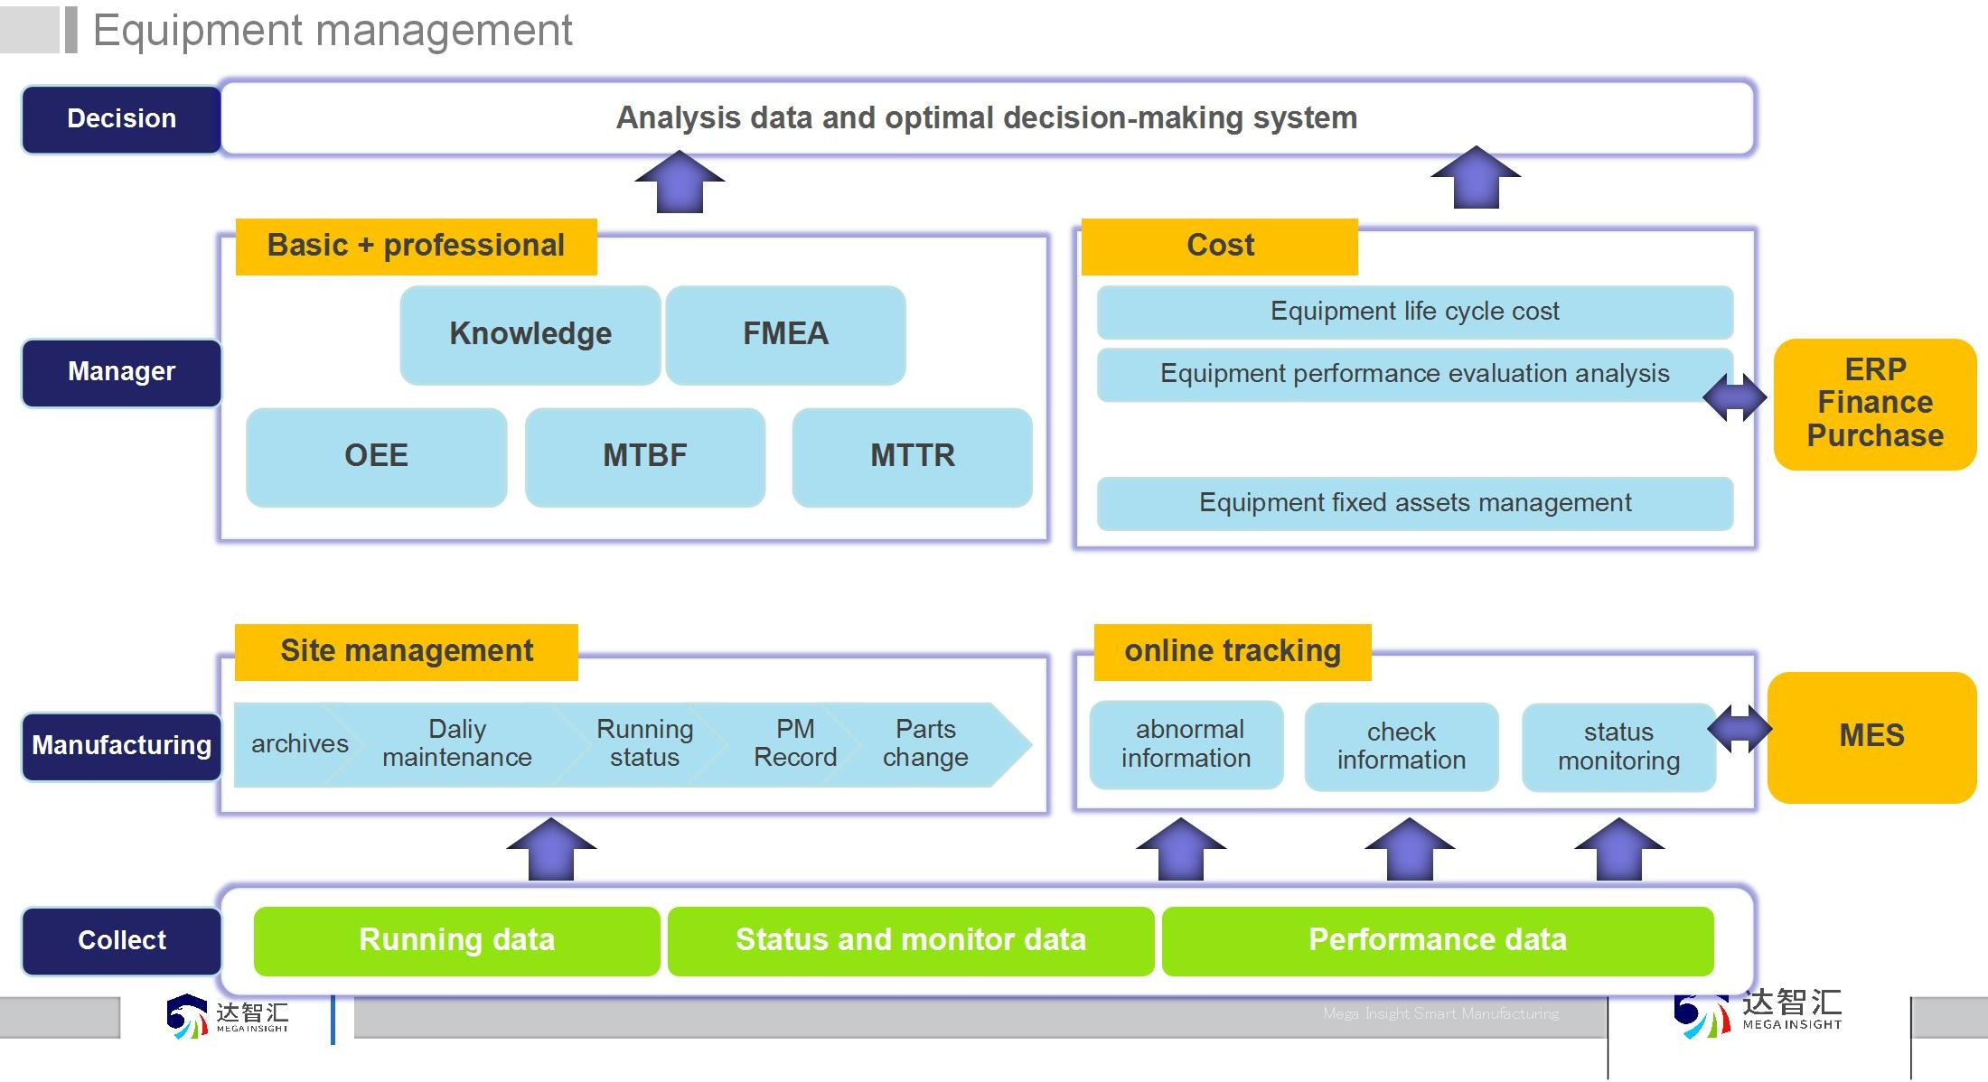



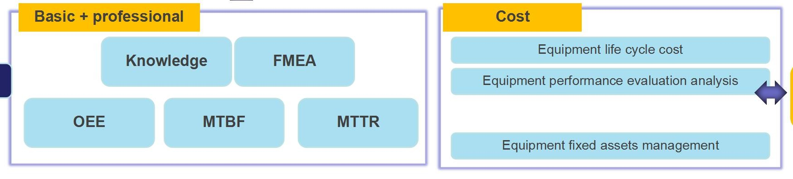



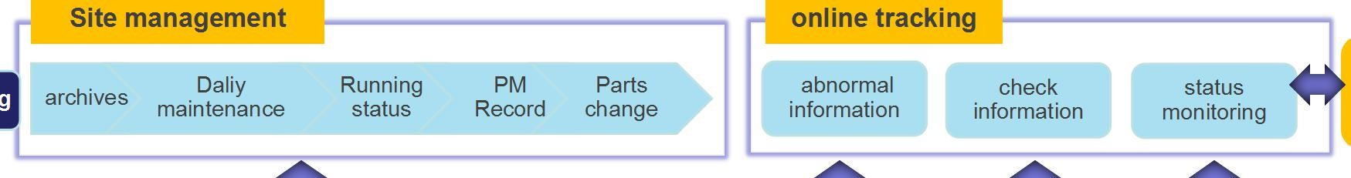







Equipment management
Decision
Analysis data and optimal decision-making system
Basic + professional
Cost
Knowledge
FMEA
Equipment life cycle cost
Manager
Equipment performance evaluation analysis
ERP
Finance Purchase
MEGA INSIGHT
OEE
MTBF
MTTR
Parts change/purchase
Equipment fixed assets management
According to the actual demand for extension and integration
MEGA INSIGHT
Site management
online tracking
Manufacturing
archives
Daliy maintenance
Running status
PM
Record
Parts change
abnormal information
check information
status monitoring
MES
Collect
Running data
Status and monitor data
Performance data
Mega Insight Smart Manufacturing

Slide 12
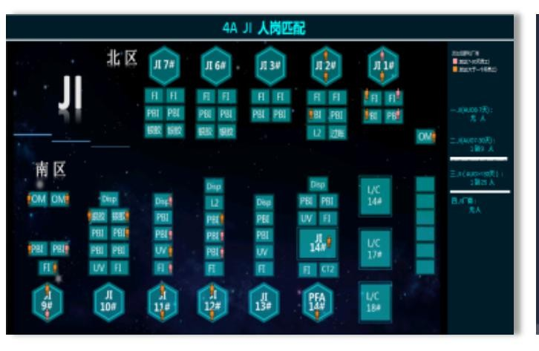
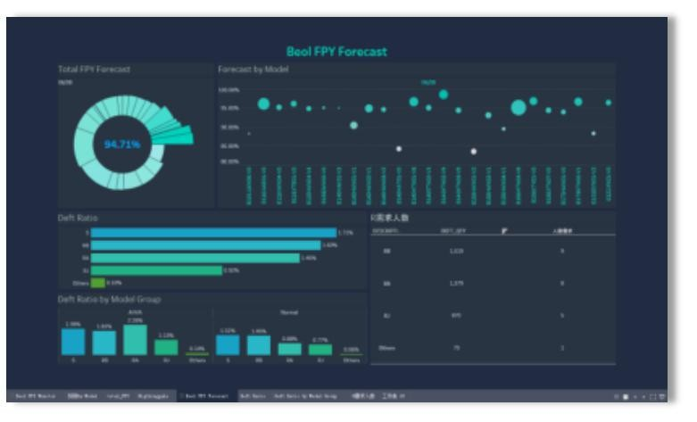
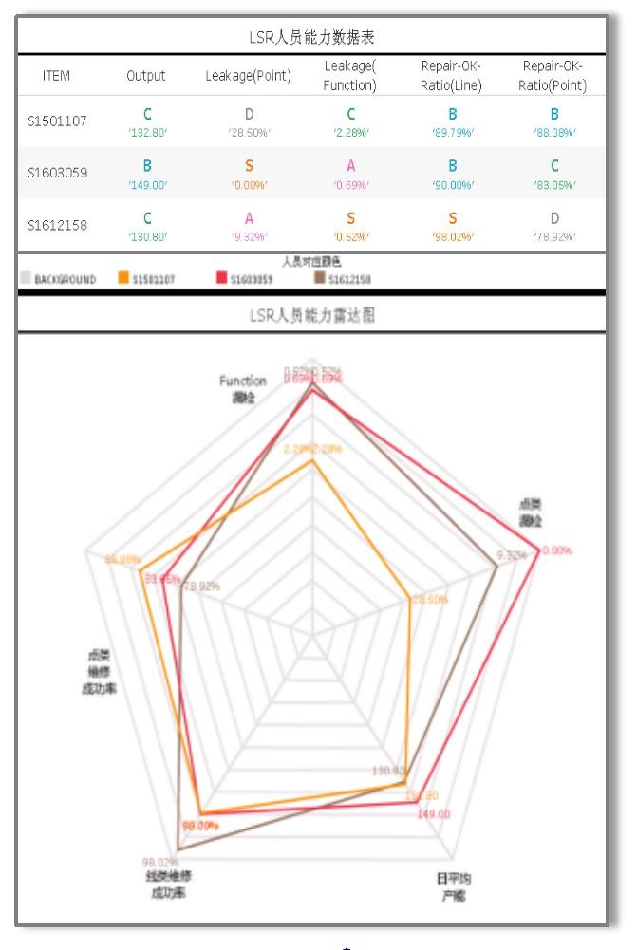
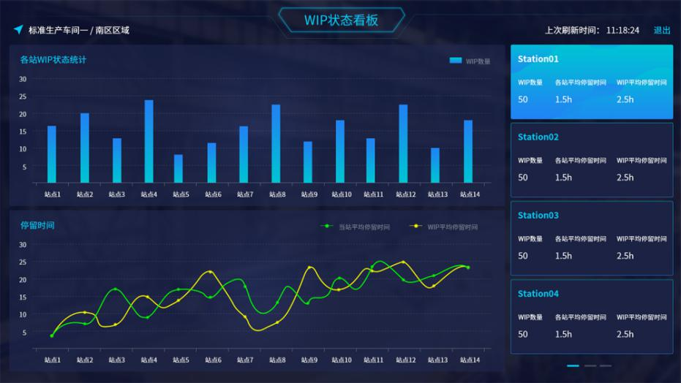
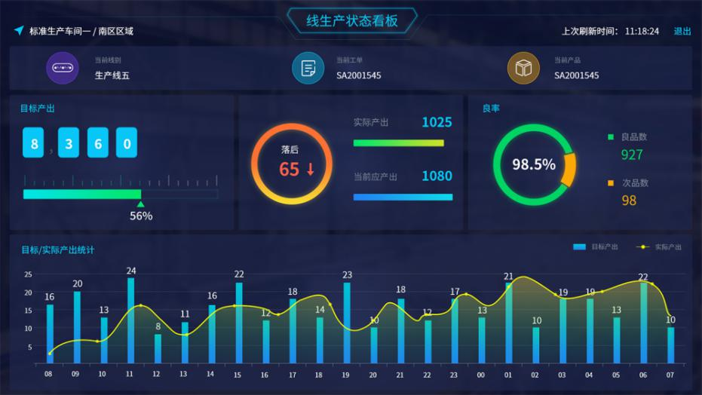
Production management kanban
MEGA INSIGHT
MEGA INSIGHT

Slide 13
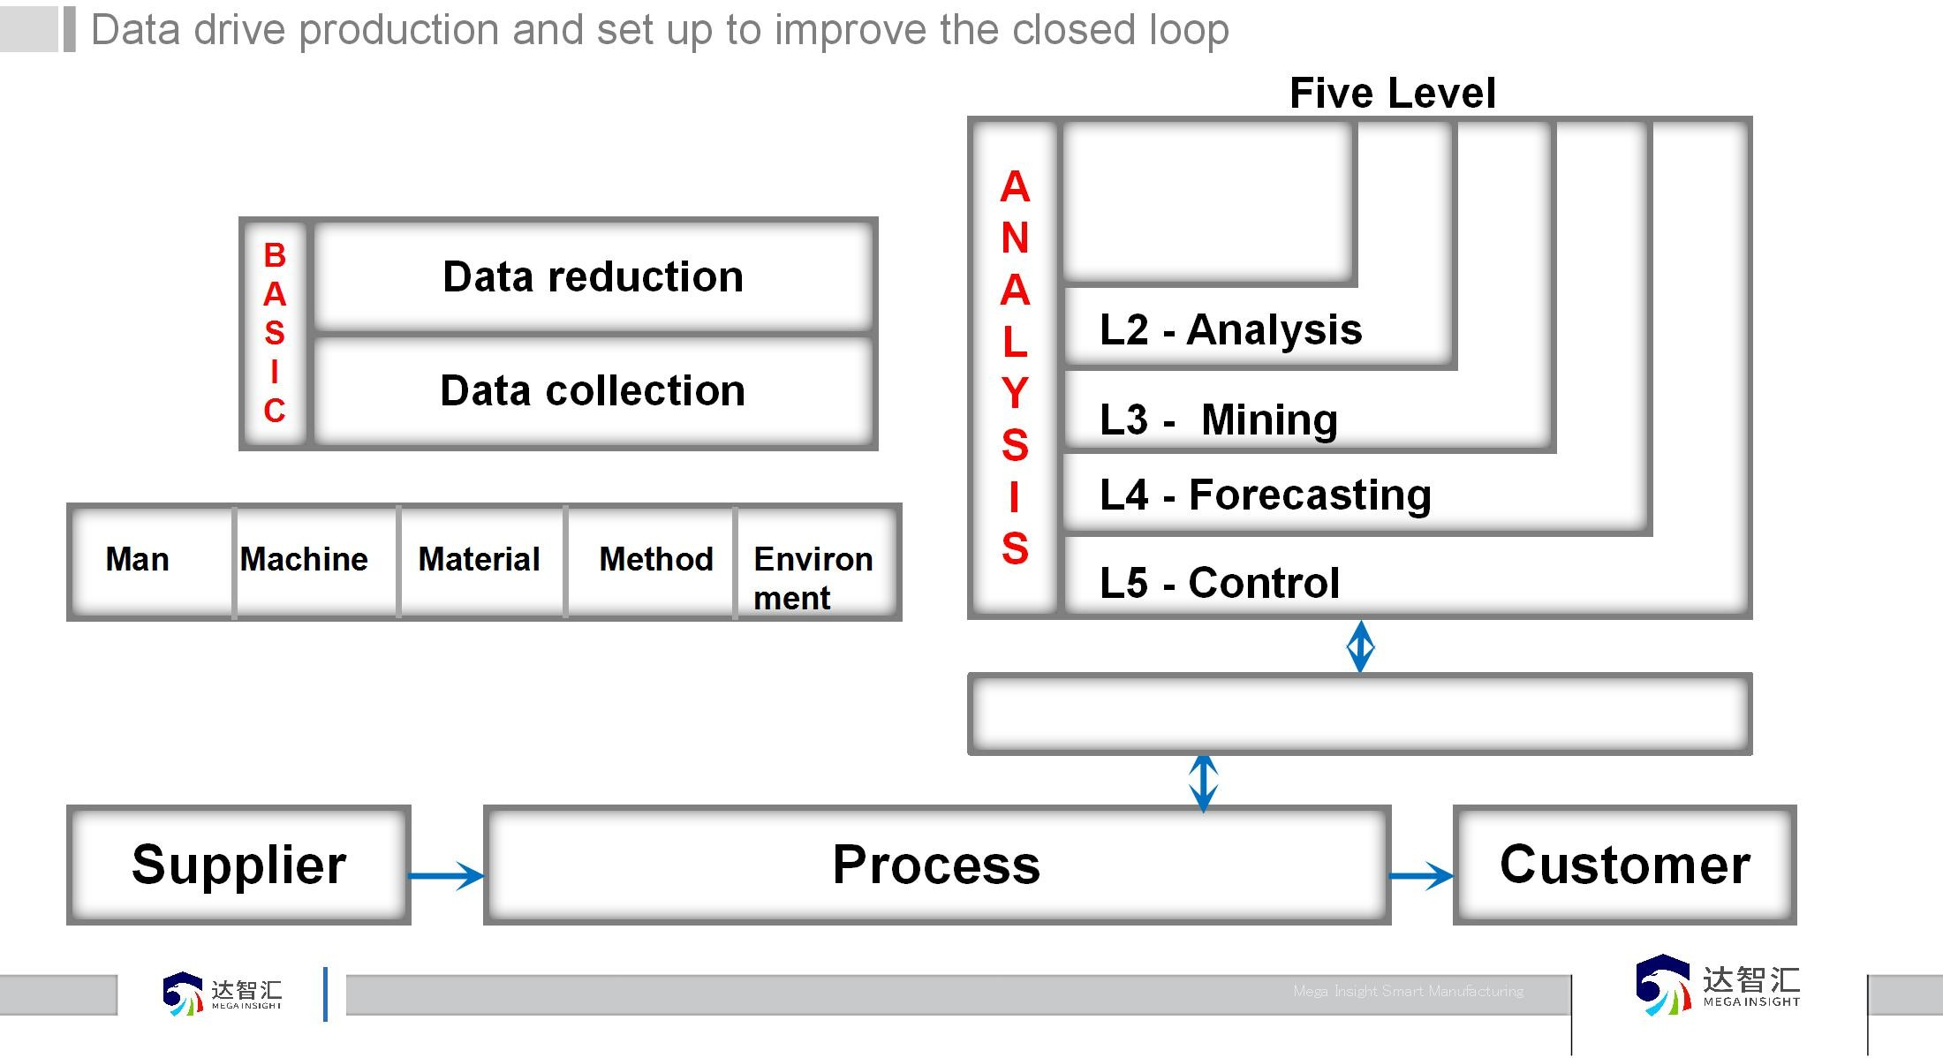
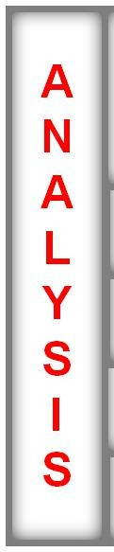
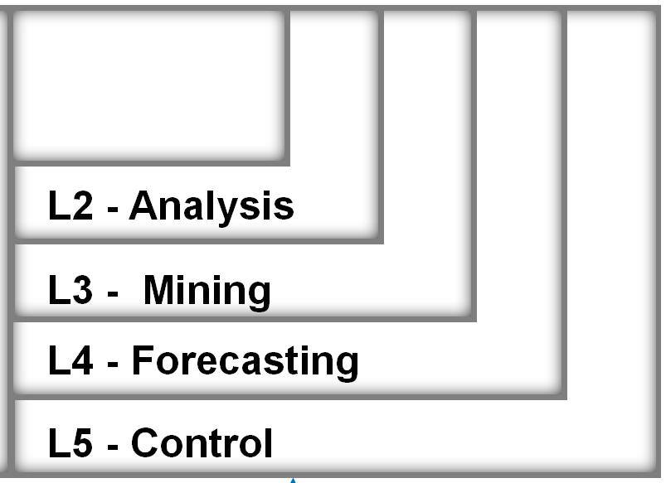
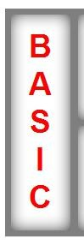


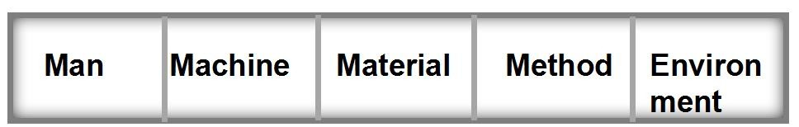


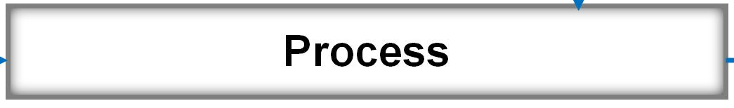
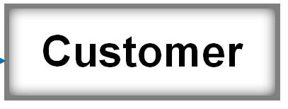
Data drive production and set up to improve the closed loop
Five Level
INSIGHT
A N A L Y
_{S} L3 - Mining
I L4 - Forecasting S
L5 - Control
L1 - Display
B A S I C
MEGA
Data reduction
L2 - Analysis
Data collection
MEGA INSIGHT
Man
Machine
Material
Method
Environ ment
Organizational management optimization
Process Customer
Supplier

Slide 14
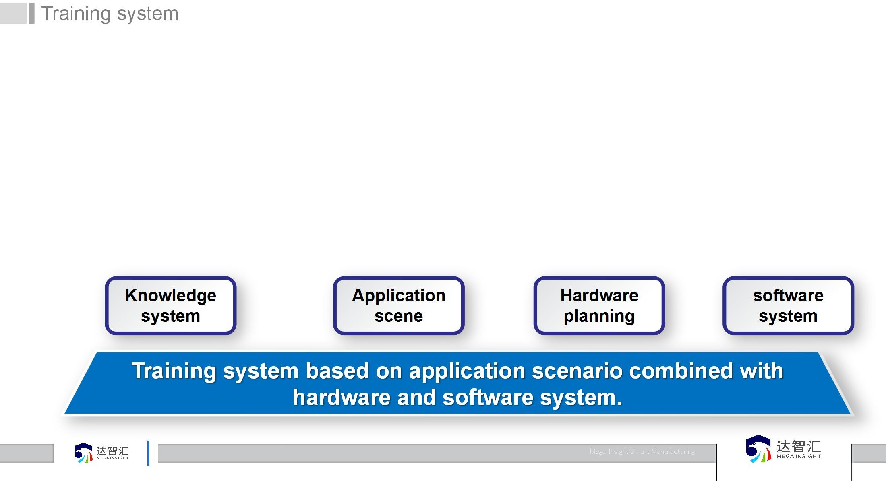
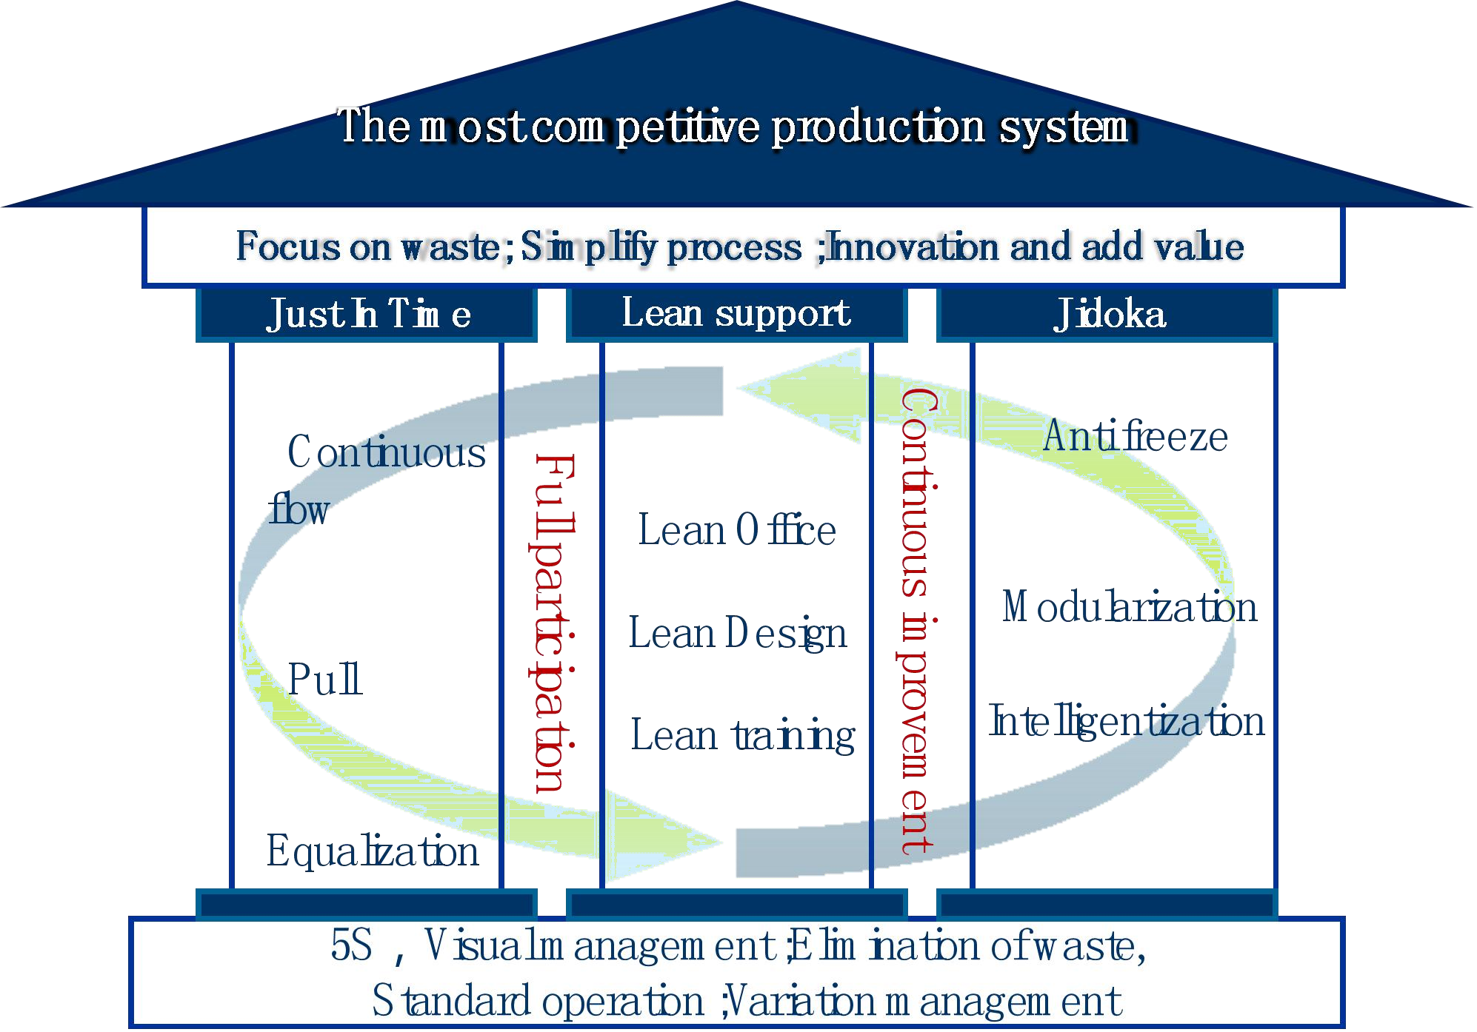
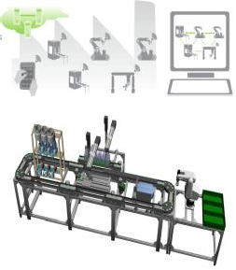

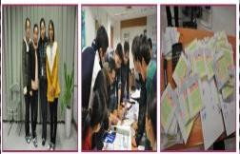


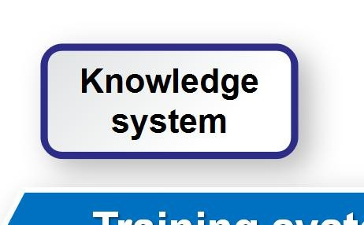
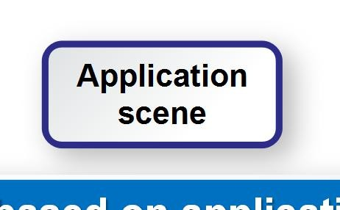
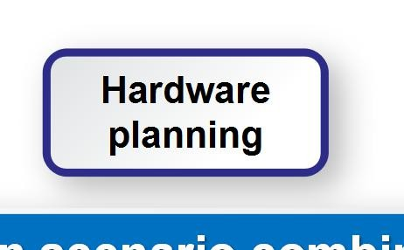
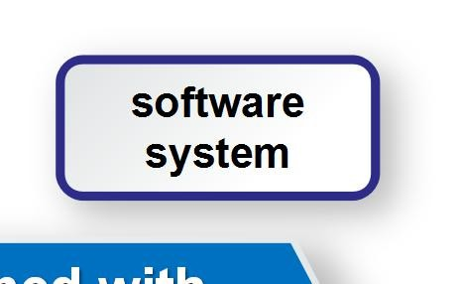
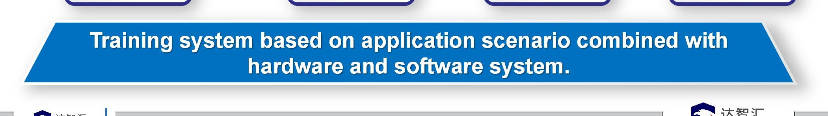
Training system
MEGA INSIGHT
Virtual factory
Knowledge system
Application scene
Hardware planning
software system
MEGA INSIGHT

Slide 15
T h a n k s
Mega Insight Smart Manufacturing（Suzhou）Corp.,Ltd.

